Slide 1


DevOps Culture and Practice Enablement
Red Hat Enterprise Linux Administration Overview

Slide 2



Topics
Access and Security
What is primary system access?
What are some ways to ensure system security?
Patching and Installing Software
How do I install software?
How do I patch and ensure systems are updated?
Automation and Management
How is Ansible used for Automation?
How can Red Hat Satellite be used for Automation and Management?
Additional Resources
Where can I go to find more information?
Notes:
Briefly introduce the topics contained within this page

Slide 3
Access and Security
NORTH AMERICA - November 2019 All-Hands Call
Notes:
Accessing Student VMs through Workstation Port Forwarding
Accessing Student VMs through Bastion Port Forwarding

Slide 4

Console Access and Security
[root@server] # cat /etc/passwd
root:x:0:0:root:/root: /sbin/nologin
Secure Root account and prevent root login
Grub password
UEFI/BIOS Password and Disable Boot Media by Default
Physically secure Data Center and access to systems
Leverage PAM and PAM FAIL LOCK
Leverage SELinux
[root@server] # cat /etc/pam.d/system-auth-ac
…
auth required pam_faillock.so
…
account required pam_faillock.so
[root@server] # cat /etc/selinux/config
SELINUX=enforcing
SELINUXTYPE=targeted
[root@server] # authconfig –enablefaillock \
--faillockargs="deny=3 fail_interval=300 unlock_time=1800" --update

Slide 5

Remote Access and Security
[root@server] # grep -i root /etc/ssh/sshd_config
PermitRootLogin no
[root@server] # grep -i password /etc/ssh/sshd_config
PasswordAuthentication no
SSH no ROOT login
SSH no passwords, require SSH keys
FirewallD and Firewall Rules
Leverage SELinux
[root@server] # systemctl status firewalld.service
● firewalld.service - firewalld - dynamic firewall daemon
Loaded: loaded (/usr/lib/systemd/system/firewalld.service; enabled; vendor preset: enabled)
Active: active (running) since Wed 2022-05-25

Slide 6
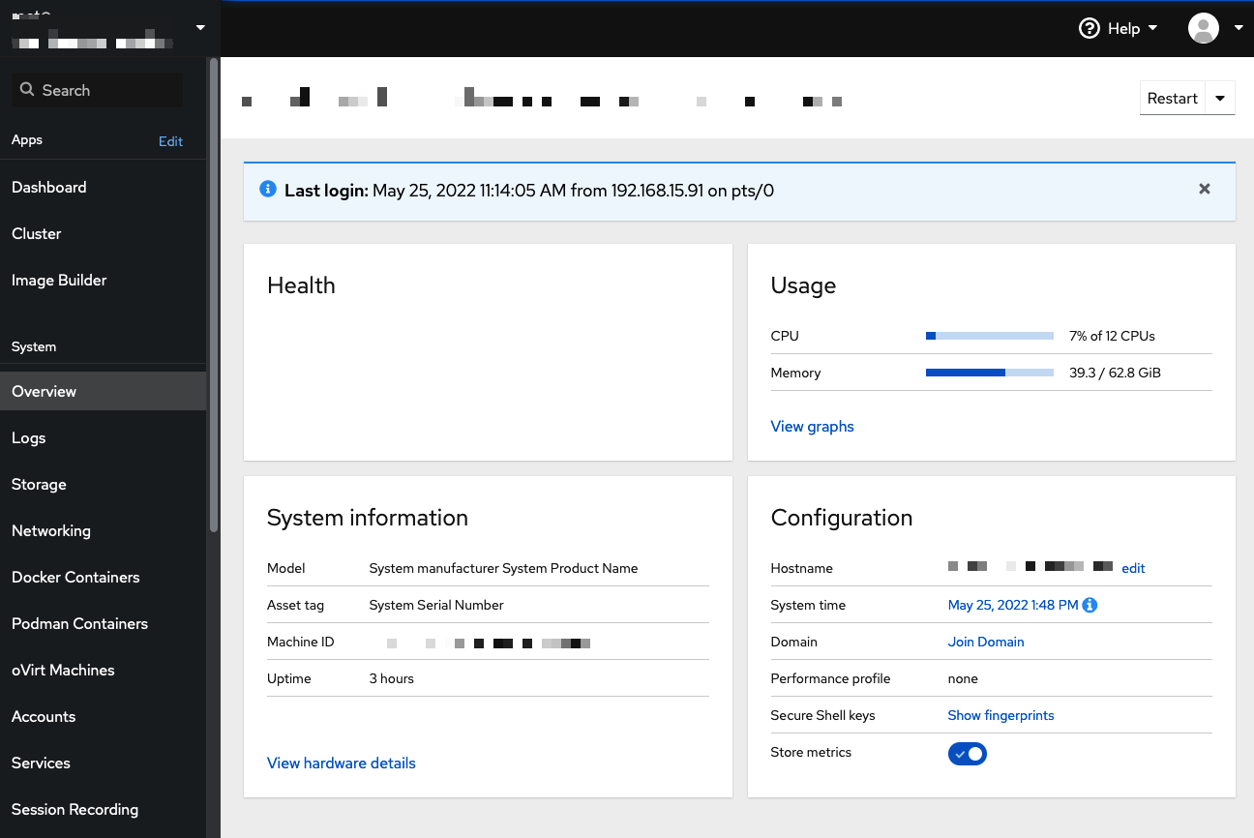
Red Hat Web Console
Accessible through a browser
Web-Based Graphical Tools
Included as part of the Cockpit project
Provides a Terminal
Provides way to control storage and networking
Provides way to look at logging
Provides a way to create SOS reports for support tickets
… and MORE

Slide 7
Patching and Software Installation
NORTH AMERICA - November 2019 All-Hands Call
Notes:
Instructor ToolKit
MOJO - New Site
RHLC
Knowledge management
RHU ROL / public ROL

Slide 8


Installing Software
[root@server] # yum install httpd
Official software packages from Red Hat are RPM based
RPMs signed by Red Hat
Use YUM or DNF to install RPM packages newer versions of RHEL
Packages and be seen with lower-level utilities like RPM

Slide 9

Patching and Updating Software
[root@server] # yum update
Why Patch?
Patching Implications
Patching to update and eliminate security issues by replacing with new applications (kernel usually requires reboot)
Patching to update software to include enhancements
Patching to update software to include Bug Fixes
Patching to update all software packages to adhere to IT Policy patching standards
Regression testing of system and custom deployed software and applications
Ensuring no new issues are bugs have been created as part of patching/update process
May require custom applications to be updated and re-deployed to utilize newly deployed software versions
Generally needs to be planned to reduce downtime of services as reboots and other interruptions can occur
[root@server] # reboot

Slide 10
Automation and Management
NORTH AMERICA - November 2019 All-Hands Call

Slide 11


Ansible Automation Platform (AAP)
Provides ability to leverage playbooks in order to automate one or more tasks for a given system outcome.
By leveraging playbooks, Ansible enables the use of version control on playbooks providing Infrastructure-as-Code (IaC) capabilities
Ansible plays are generally idempotent and can be run regularly on a system to keep it in compliance with configuration files and IT Security Policies preventing rogue administrators making untracked changes
Provides Ansible (Tower / Controller) as a web-based UI which allows scheduling and running of Ansible jobs from playbooks and integration into version control systems such as Git.
---
- name: install apache
hosts: web
become: yes

Slide 12

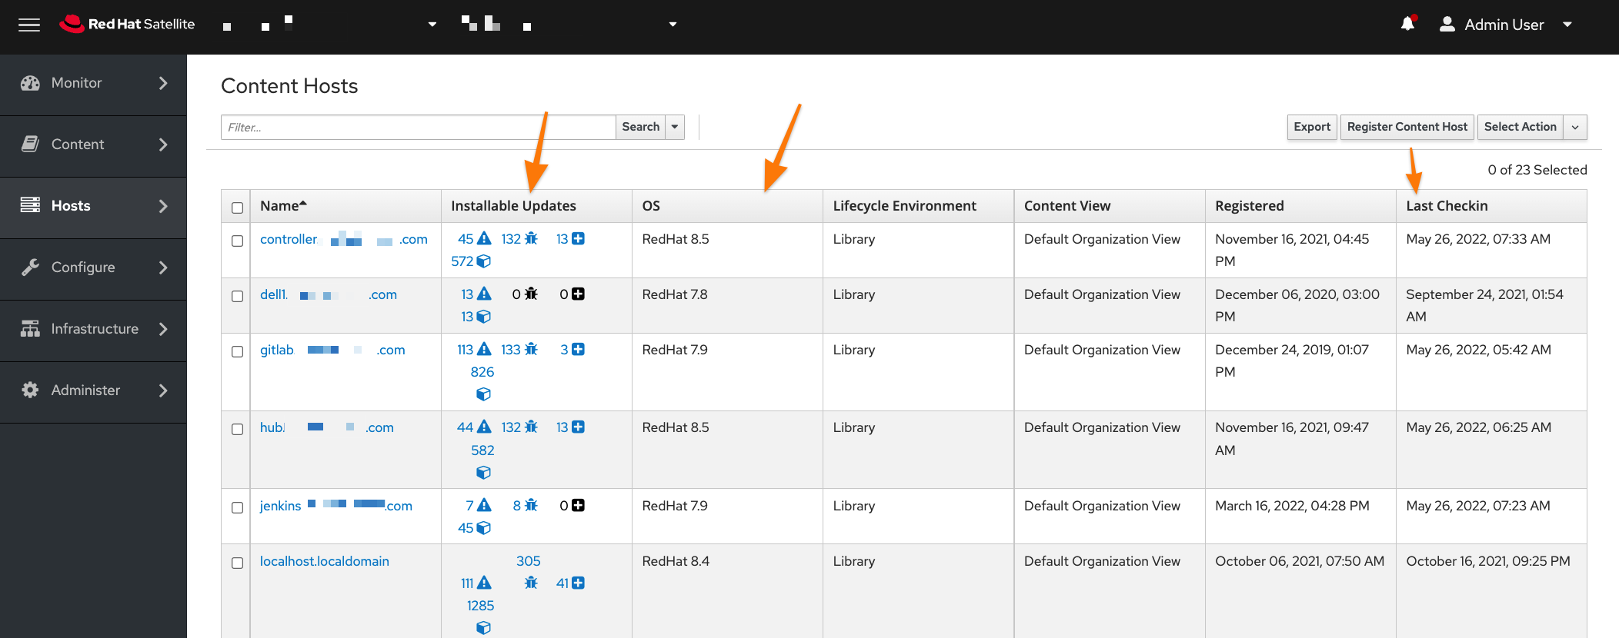
Red Hat Satellite
Provides centralized management and patching of subscribed Red Hat Enterprise Linux systems
Provides reporting and overview of systems and system statuses
Capable of managing both virtualization and cloud resources to create/destroy virtual machines as well as various pieces of lifecycle management (including power on/off of systems)
Ability to schedule remote jobs (including running of Ansible playbooks and roles)
Capable of both cloud and bare-metal provisioning using a variety of methods (base image, PXE, etc.)

Slide 13
References & More Information
NORTH AMERICA - November 2019 All-Hands Call

Slide 14

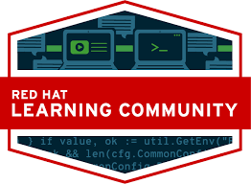
Red Hat Learning Subscription (RHLS) & Red Hat Learning Community (RHLC)
https://rol.redhat.com/
https://learn.redhat.com/
Online Learning Environment
Access to Red Hat Training Catalog with 24/7/365 access to training materials and hands-on lab environment.
Some subscriptions include five (5) exams and two (2) retakes.
New RHLS Premium Subscription includes instructor led 3-hour schedulable sessions.
Online Learning Forum open for everyone to participate
Location for Red Hat Course certificates of attendance/completion
Contains groups of target areas where questions can be posted and discussed among peers
Contains relevant articles regarding Red Hat Training and Technology offerings

Slide 15
Additional Resources
Ansible Automation Platform – https://console.redhat.com/ansible/ansible-dashboard
Ansible Documentation – https://docs.ansible.com/ansible/latest/index.html
Ansible Automation Workshop (Slides) – https://github.com/tmichett/AAP_Webinar/blob/main/Presentation/Slides/Ansible%20Automation%20Workshop%20(Past%2C%20Present%2C%20and%20Future)%20-%20Red%20Hat%20Training%20and%20Certification.pdf
Github Sample Playbooks – https://github.com/tmichett/AnsiblePlaybooks
Github Containers – https://github.com/tmichett/OCP_Demos
Red Hat Training Courses: RH124, RH134, RH294, RH342, RH358, RH403, and DO374
https://www.redhat.com/en/services/training-and-certification

Slide 16
Thank you
Red Hat is the world’s leading provider of enterprise open source software solutions. Award-winning support, training, and consulting services make Red Hat a trusted adviser to the Fortune 500.
E-Mail: tmichett@redhat.com

